Slide 1
BRITISH AIRLINES REVIEW ANALYSIS

Slide 2
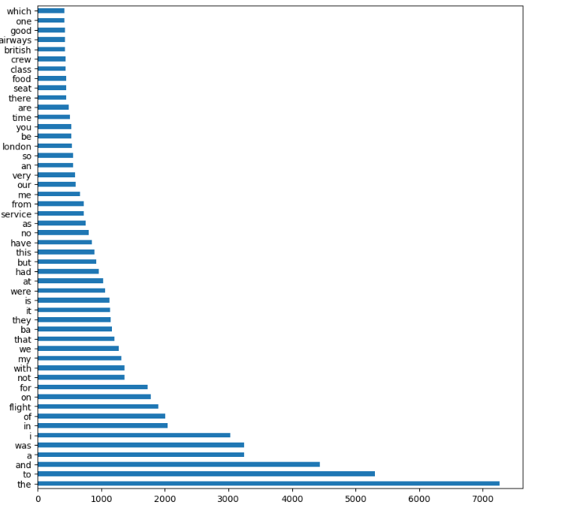
RESULT
KEY TOPICS
The frequency chart below shows that the key topics within the reviews include “service”, “flight”, “seat” and “food”, showing that people are actively talking about their experience and staff.
Sentiments
Out of 1000 reviews, 418 were positive, 582 were negative. This means that majority of reviews were polarized as either positive or negative.

